Slide 1

“Your Project Name”
Task - 3

Slide 2
Social Media
Your Project Introduction
LMS Username | Name | Batch
2115a24 | P. Sai Krishna | A2
2115a247 | V .Venkata sai | A2
2115a216 | B vinod kumar Reddy | A2
2115a223 | K . Avinash | A2

Slide 3
Task 3 :: Frontend (Module 3)
Create UI and implement various components using react
Split design into components and Higher order Components
Define structure of the components
Set the basic ui components with dummy data
Integrate the APIs to frontend to ensure the dynamic feature of website
Point base api to the severs base url
Design api calls for each element
Handle errors in the output
Render output of apis to different low level components
Secure content of post apis
Evaluation Metric:
100% Completion of the above tasks
Learning outcome
Developing complicated UI using react components
Using props drilling and context to pass variables
Getting familiar with different type of api calls
Handling different input data
Managing states according to response api

Slide 4
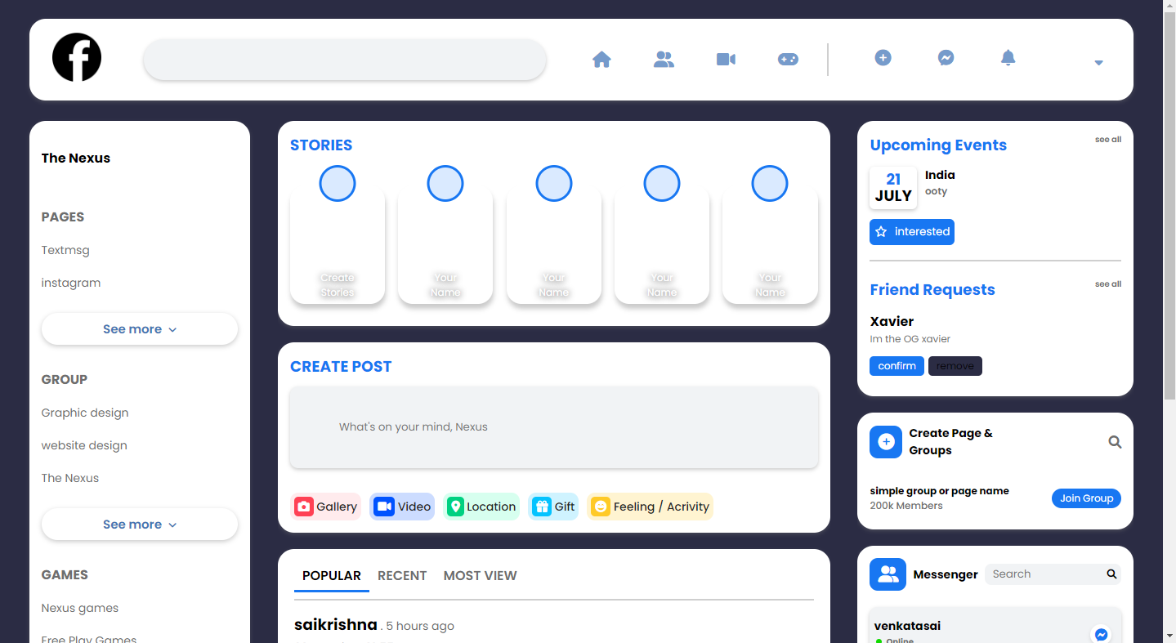
Step-Wise Description
Facebook UI output snapshots..

Slide 5
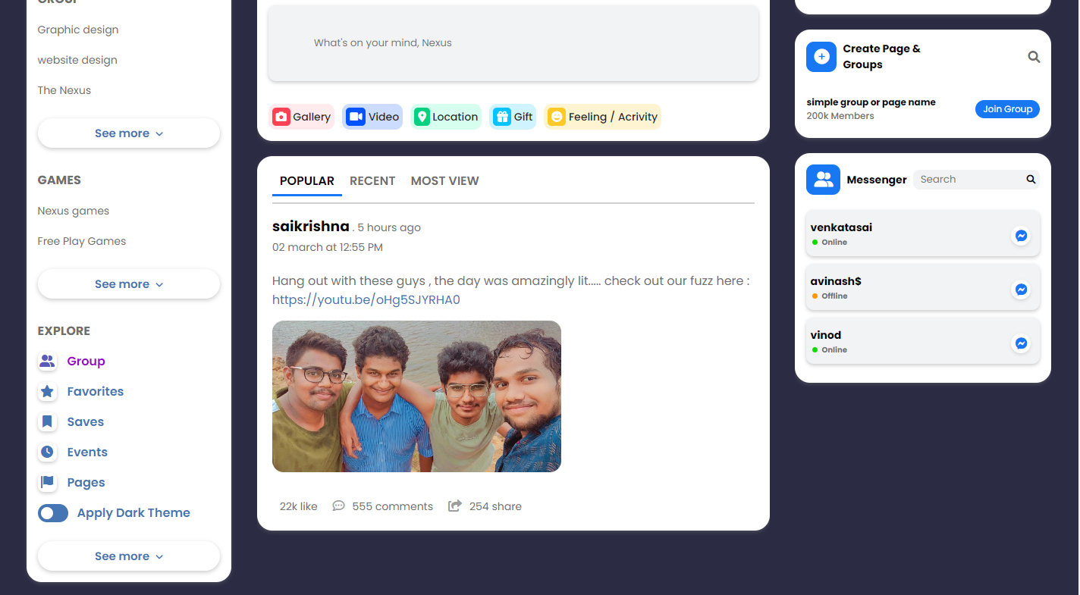

Slide 6
Assessment Parameter
Create folder structure for react application
Render Conditional components
Write Functions for event handling
Check-List
Overall UI of the project
Use context api or props drilling
Handling broken links
Handle response from api's
Optimizing render cycle

Slide 7
Submission Github
https://github.com/Vinodkumarreddy08/social-media.git

